Slide 1
KERBEROS

Slide 2
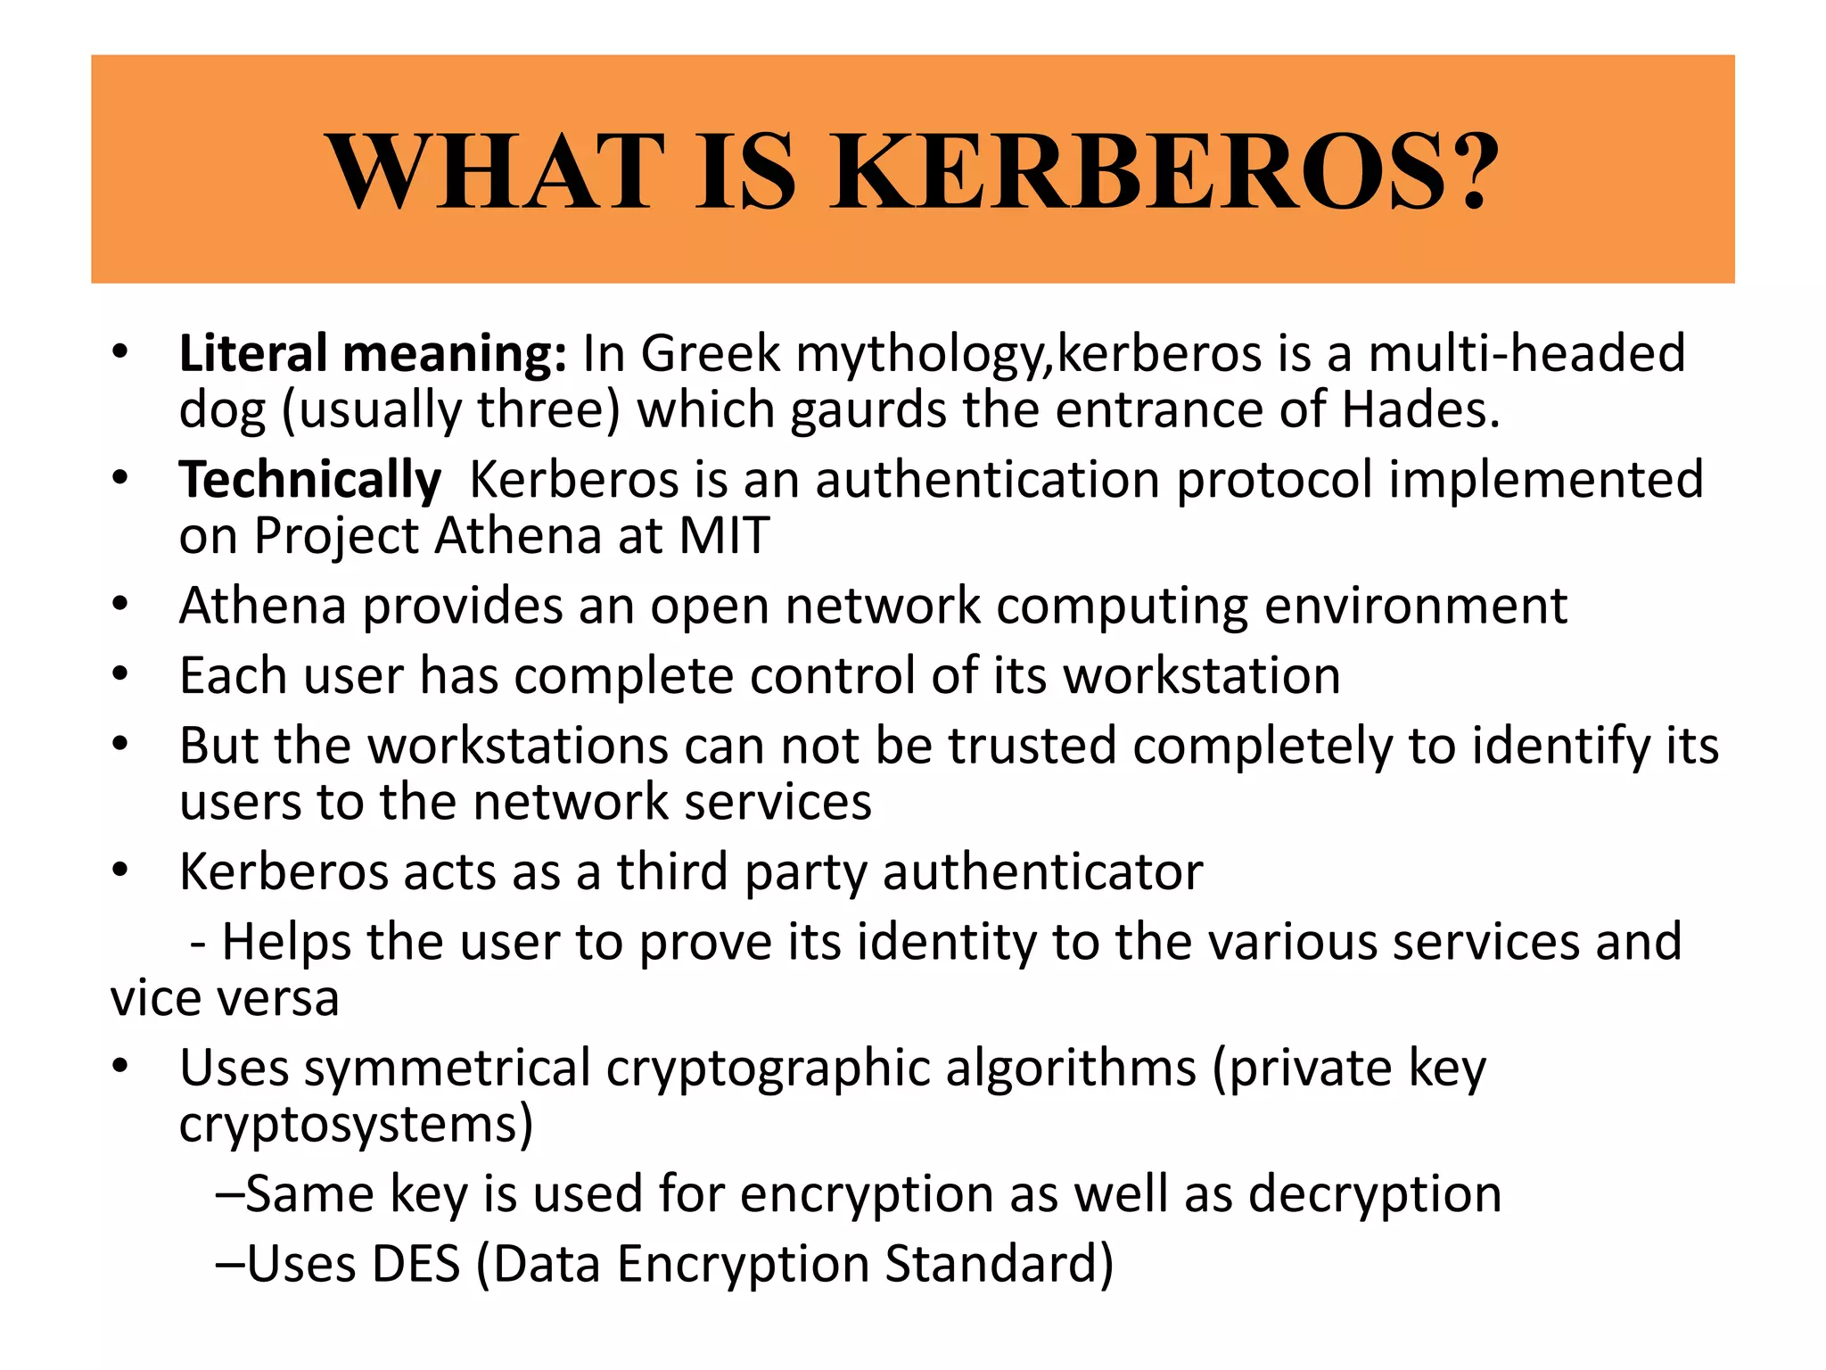
Notes:
is a computer-network authentication protocol ,hades…নরক,,, Massachusetts Institute of Technology (MIT)

Slide 3
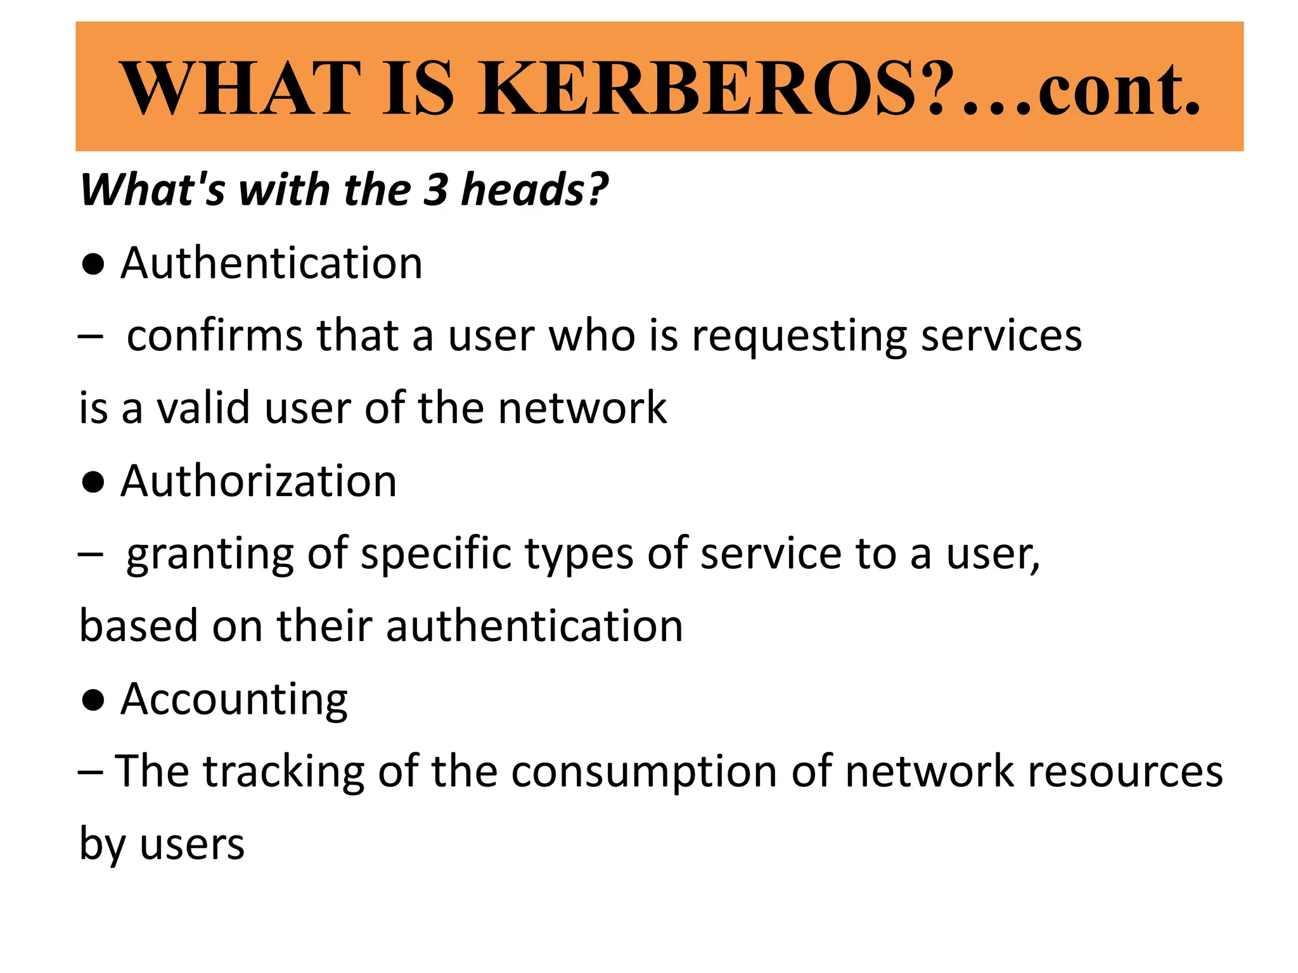

Slide 4
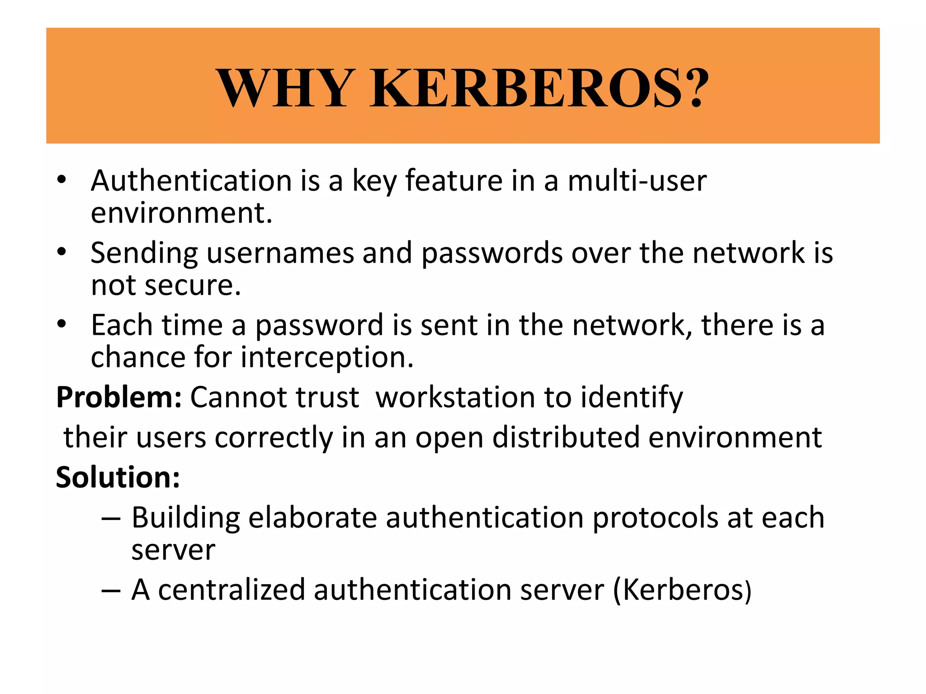

Slide 5
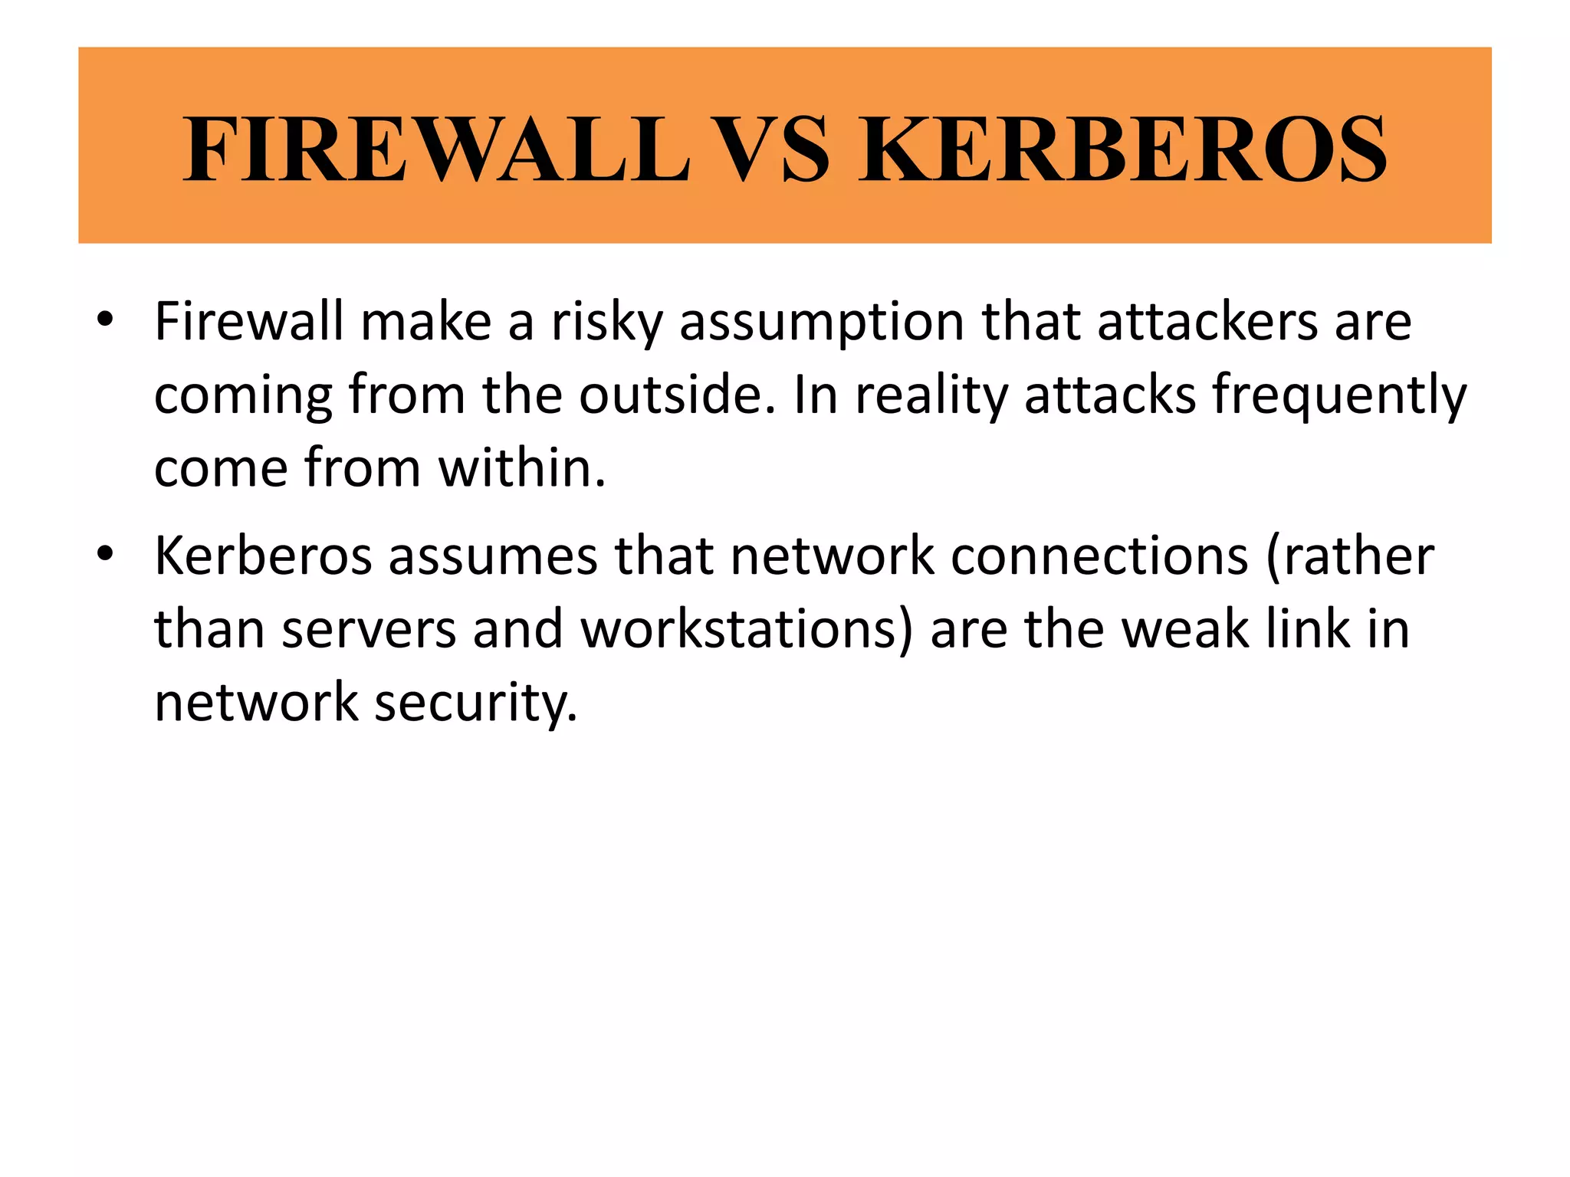

Slide 6
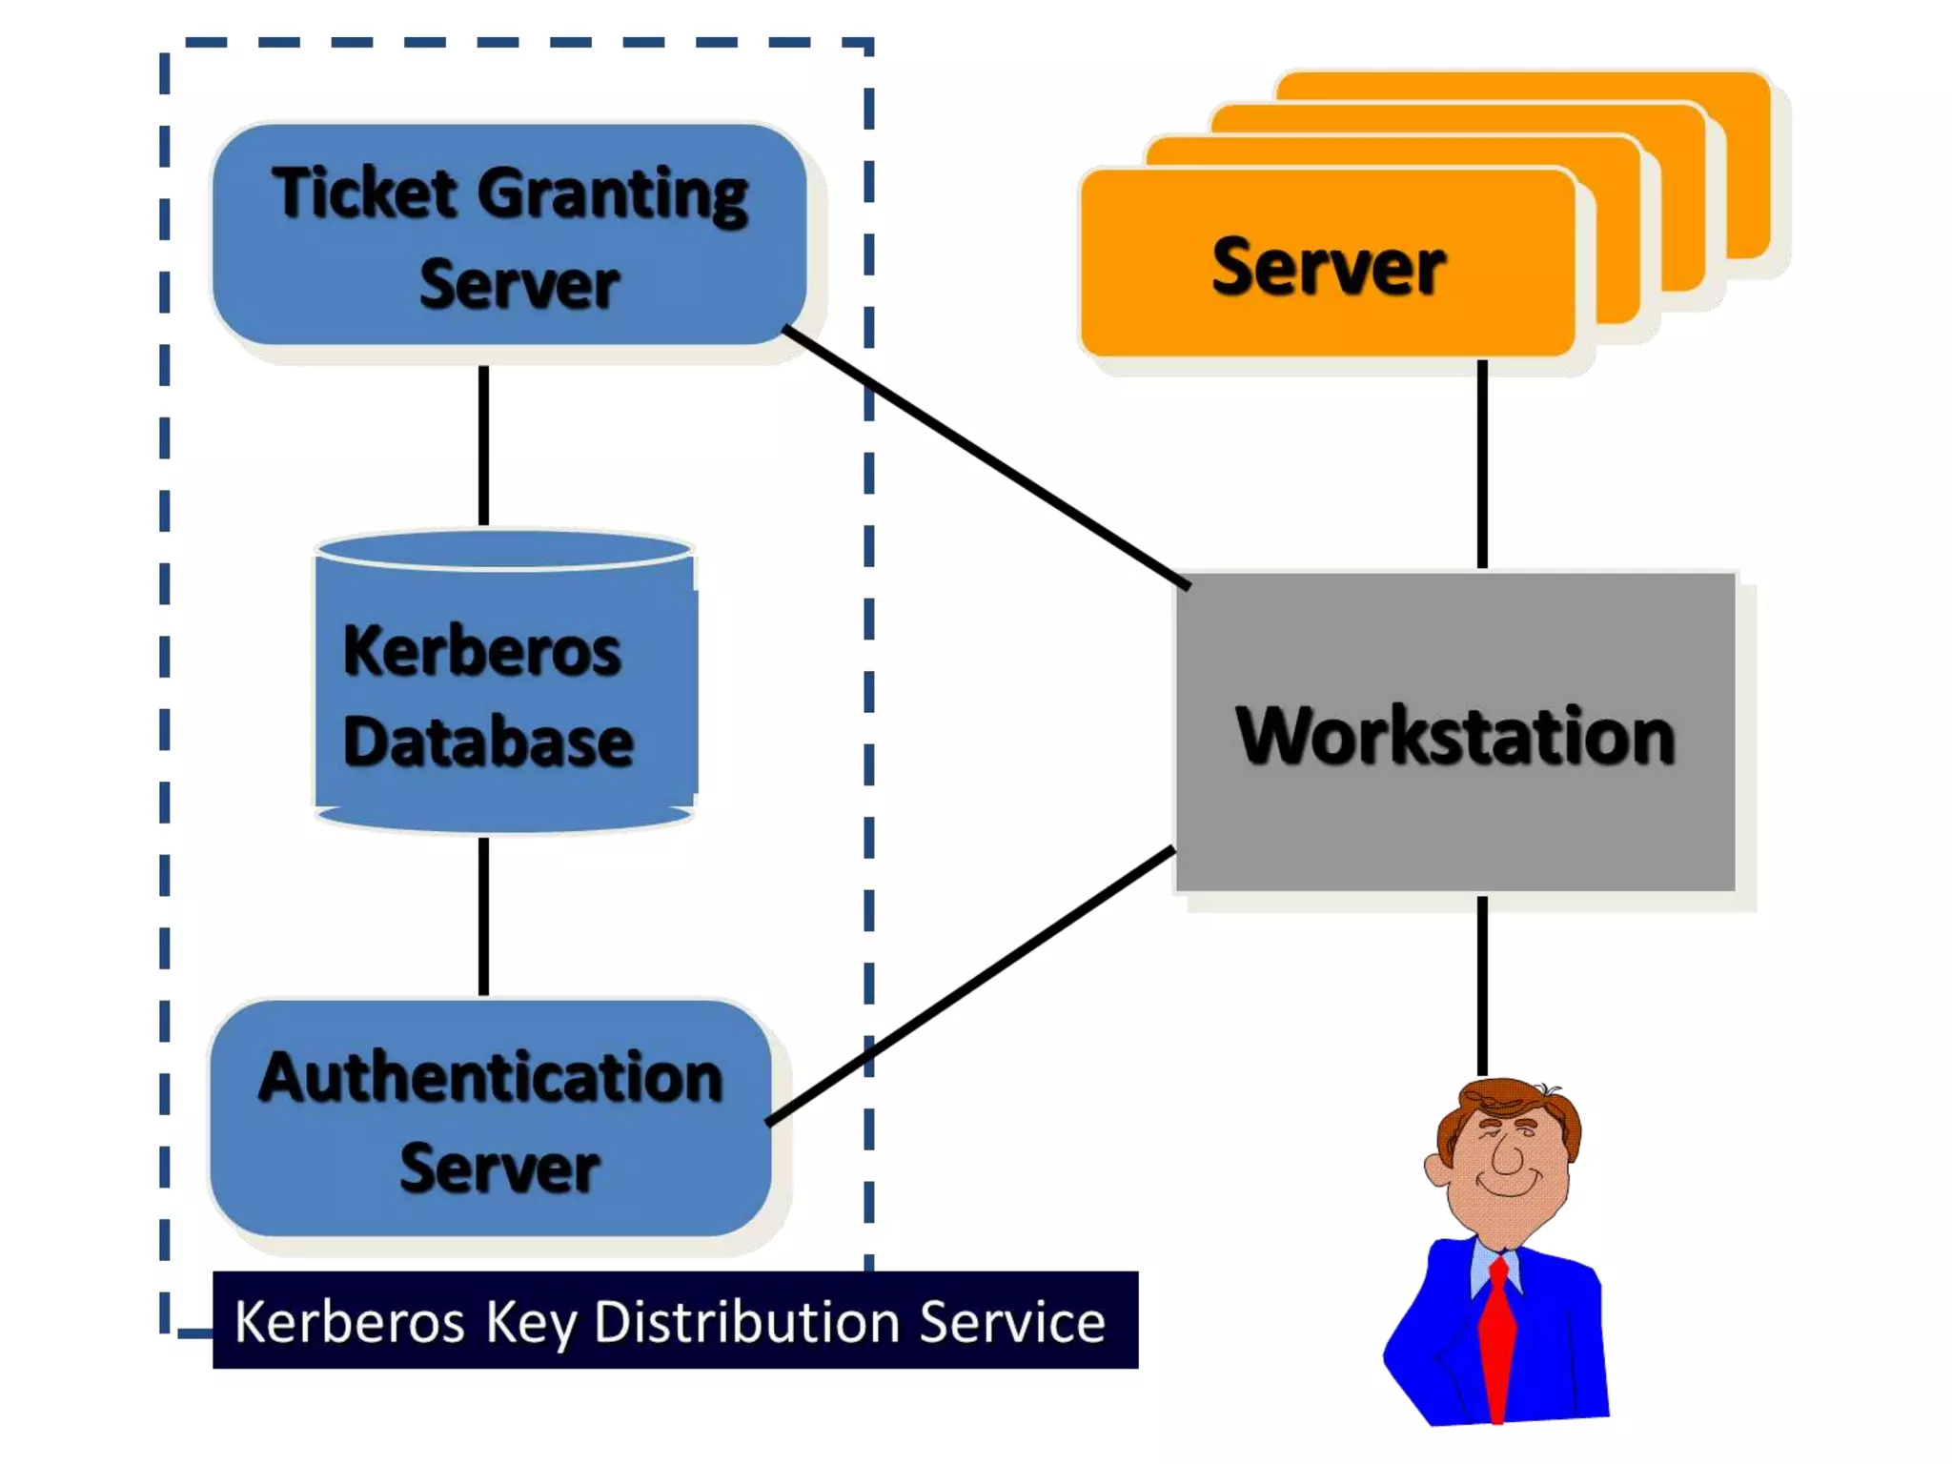

Slide 7
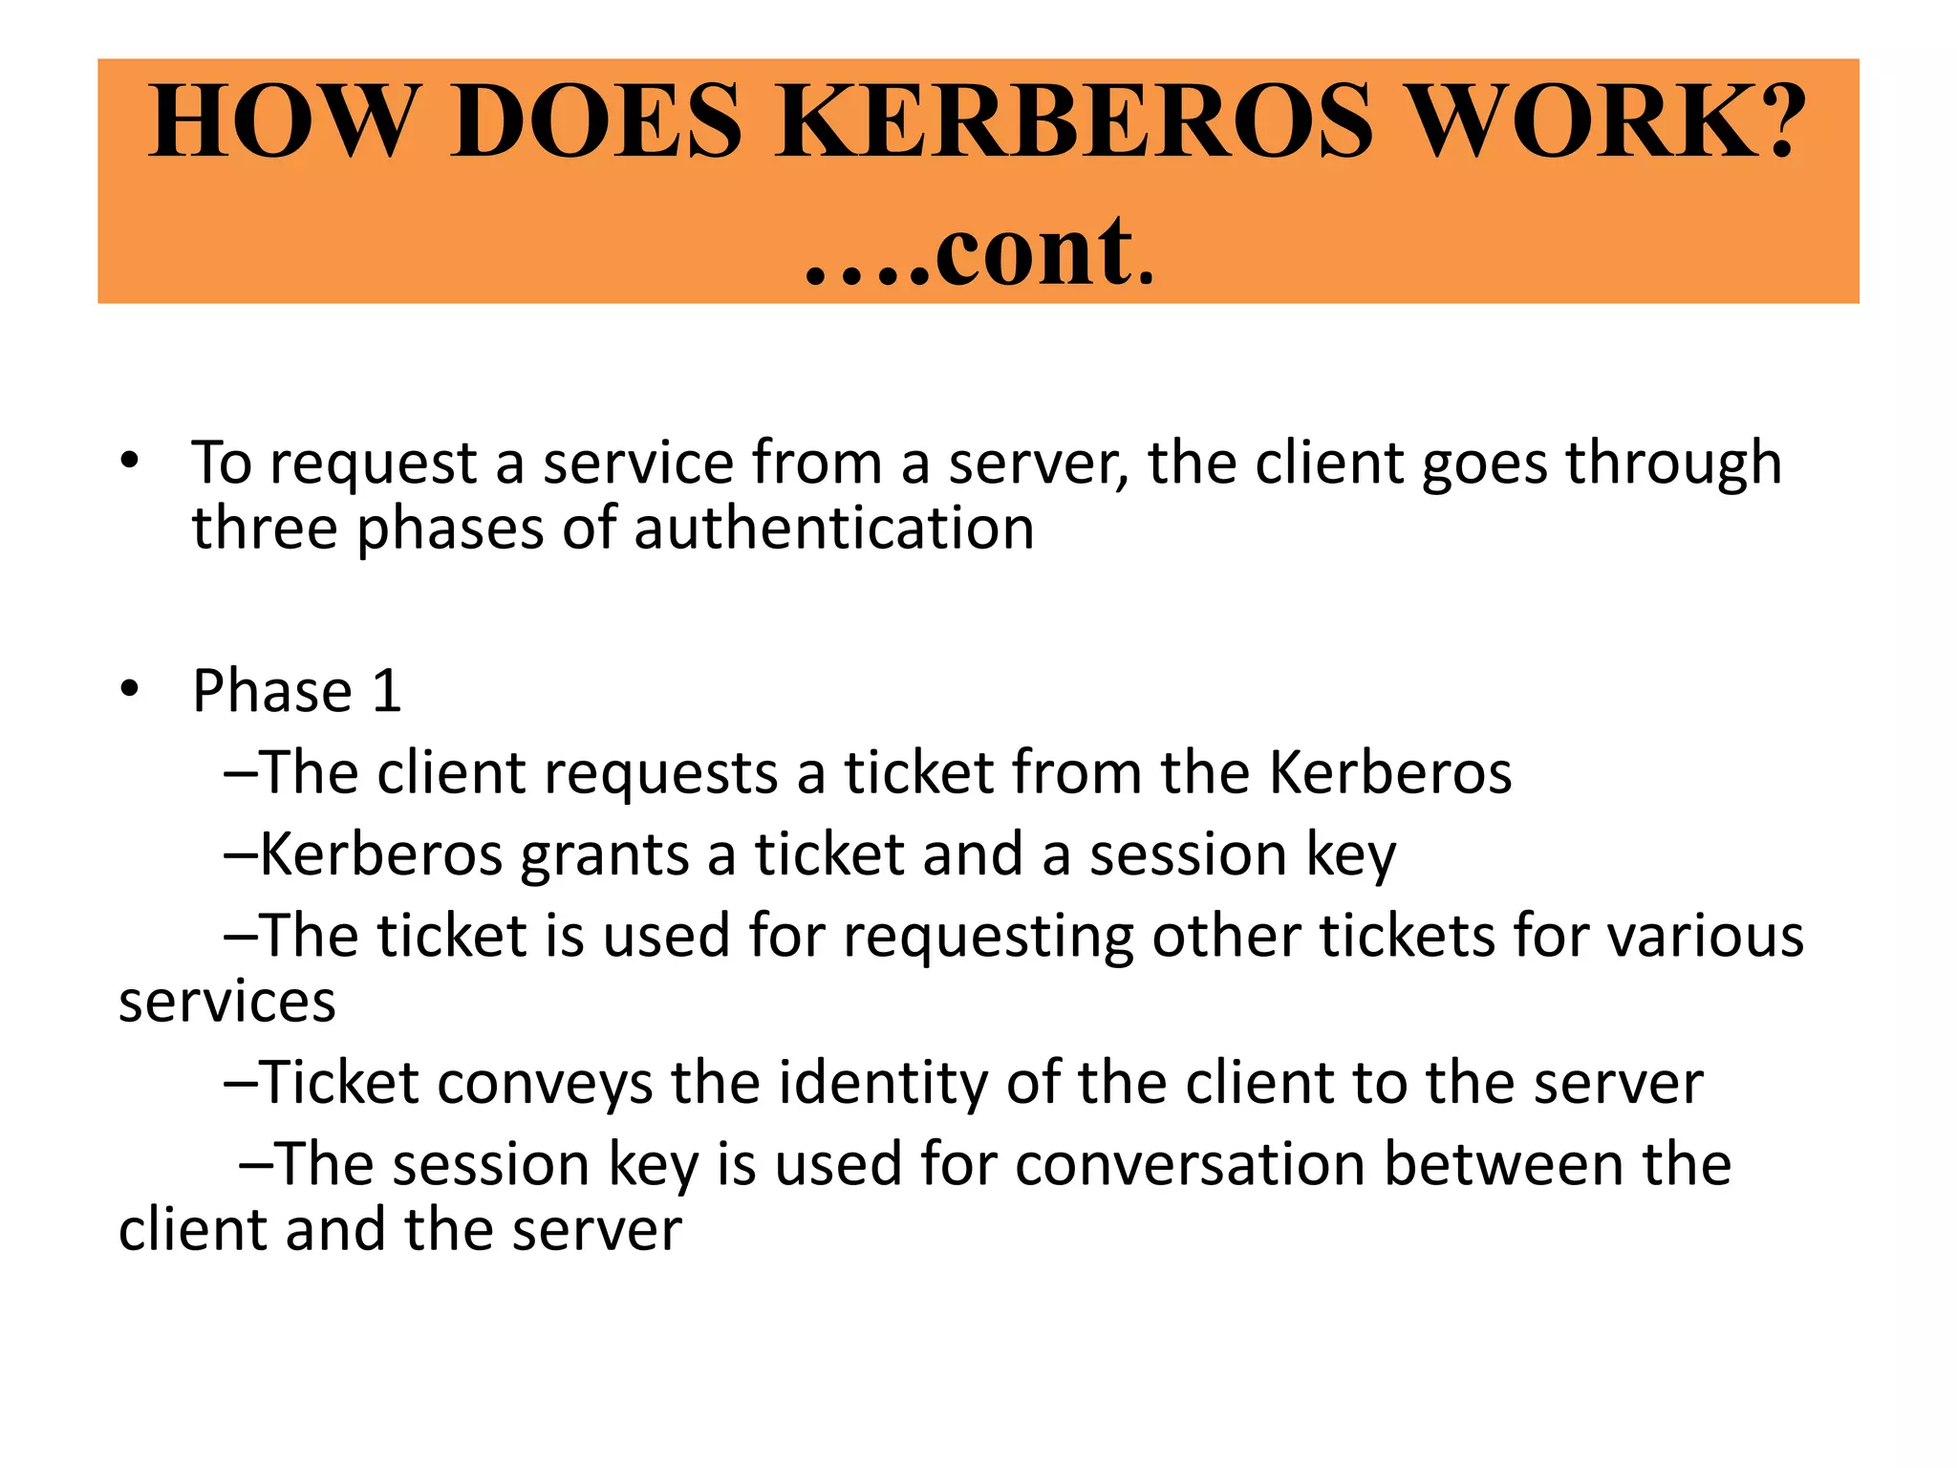

Slide 8
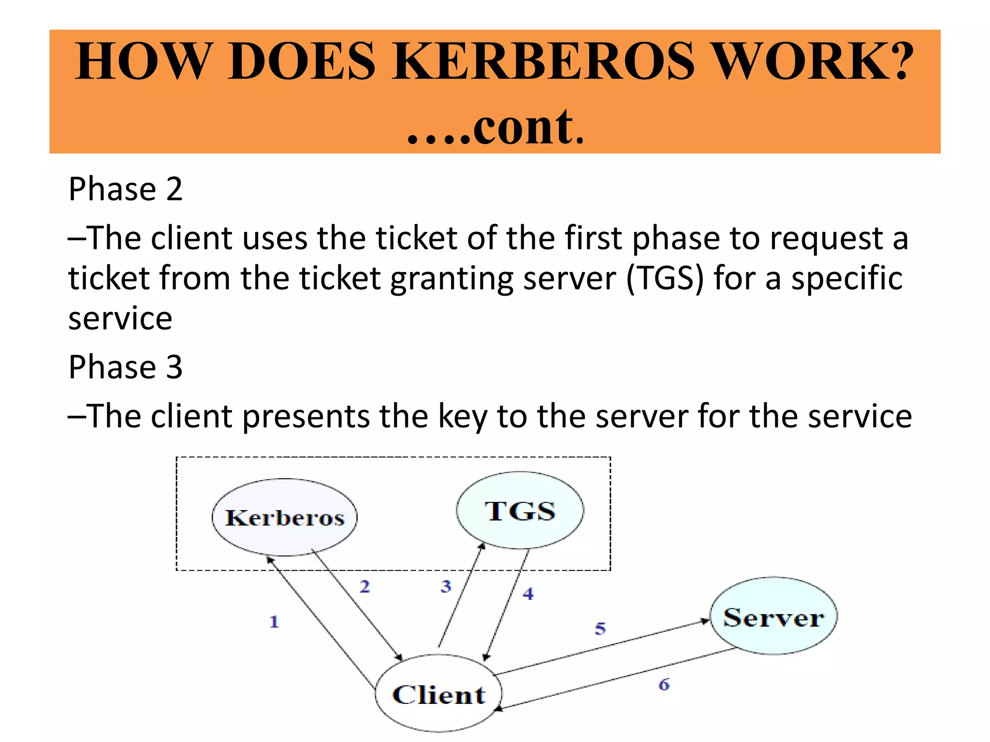

Slide 9
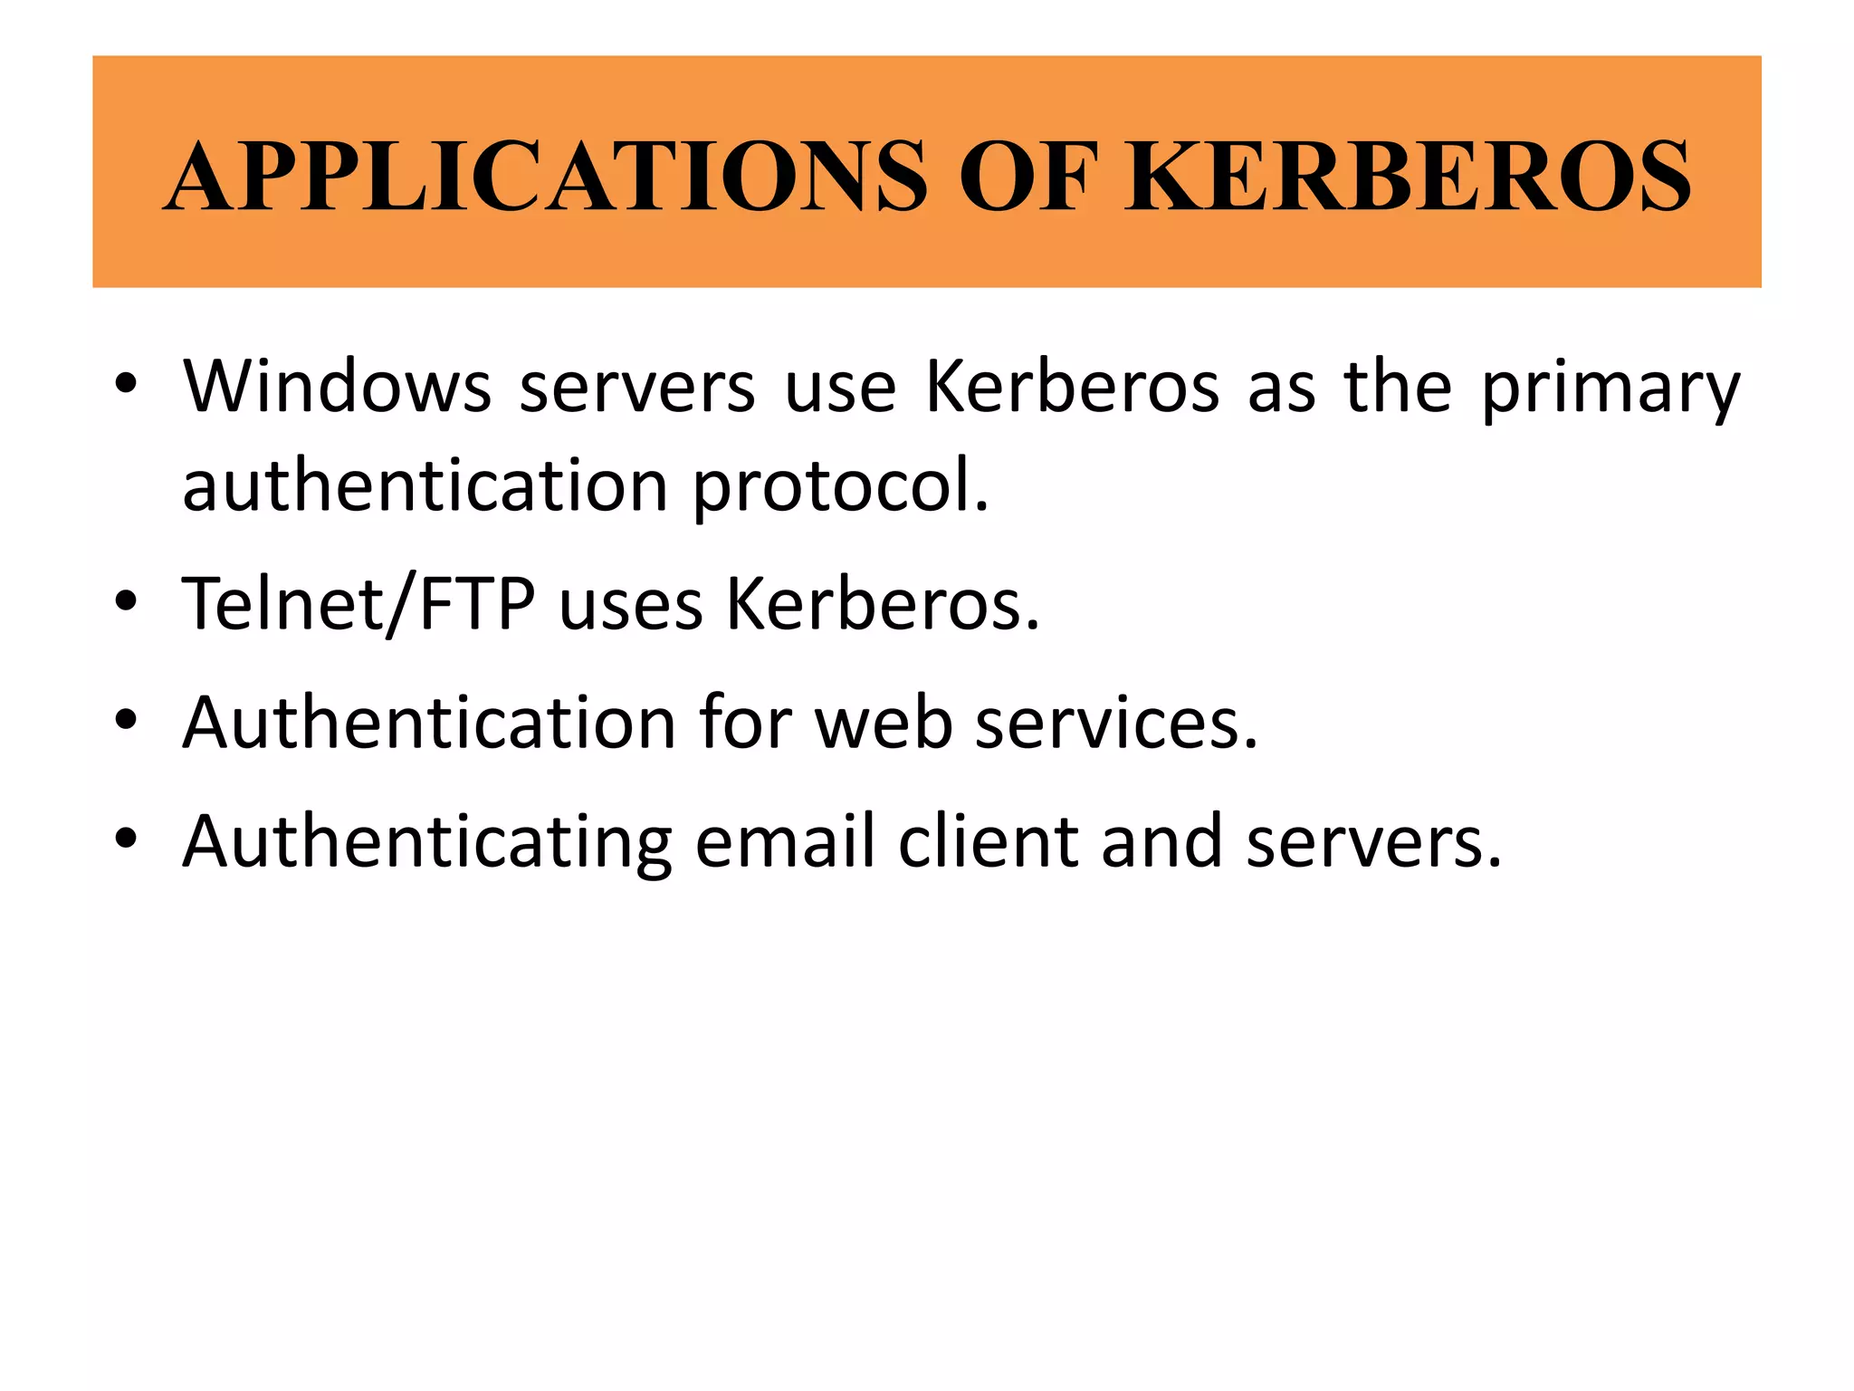

Slide 10
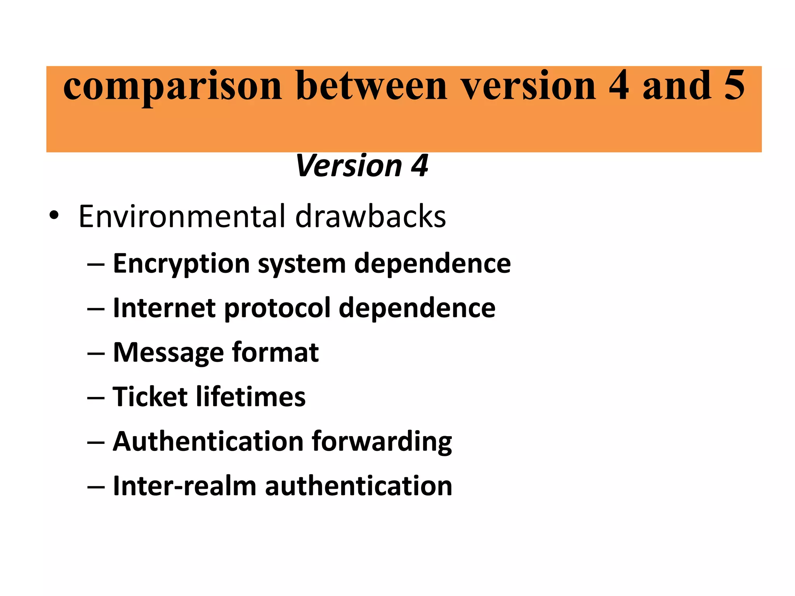
Notes:
Inter-realm.. রাজ্য

Slide 11
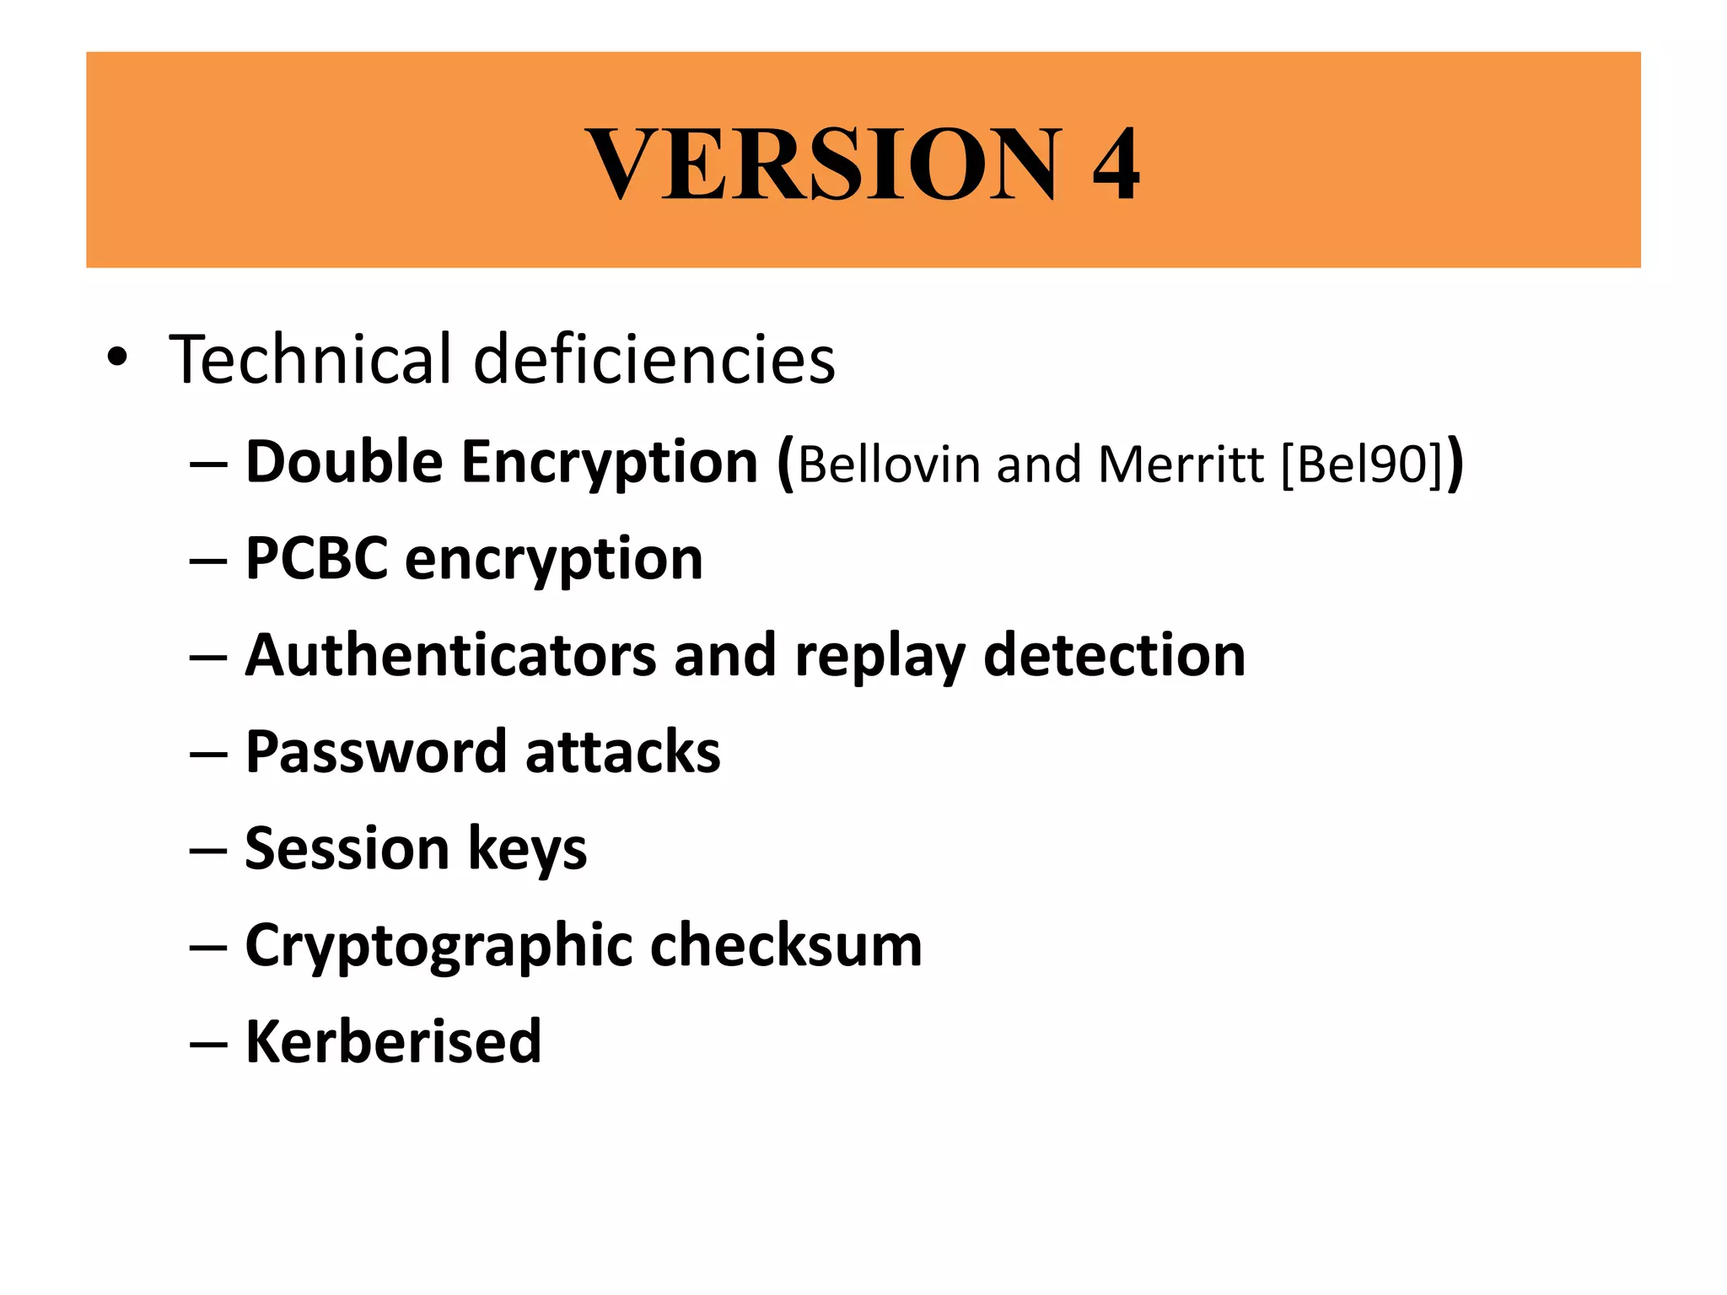
Notes:
Propagating cipher block chaining

Slide 12
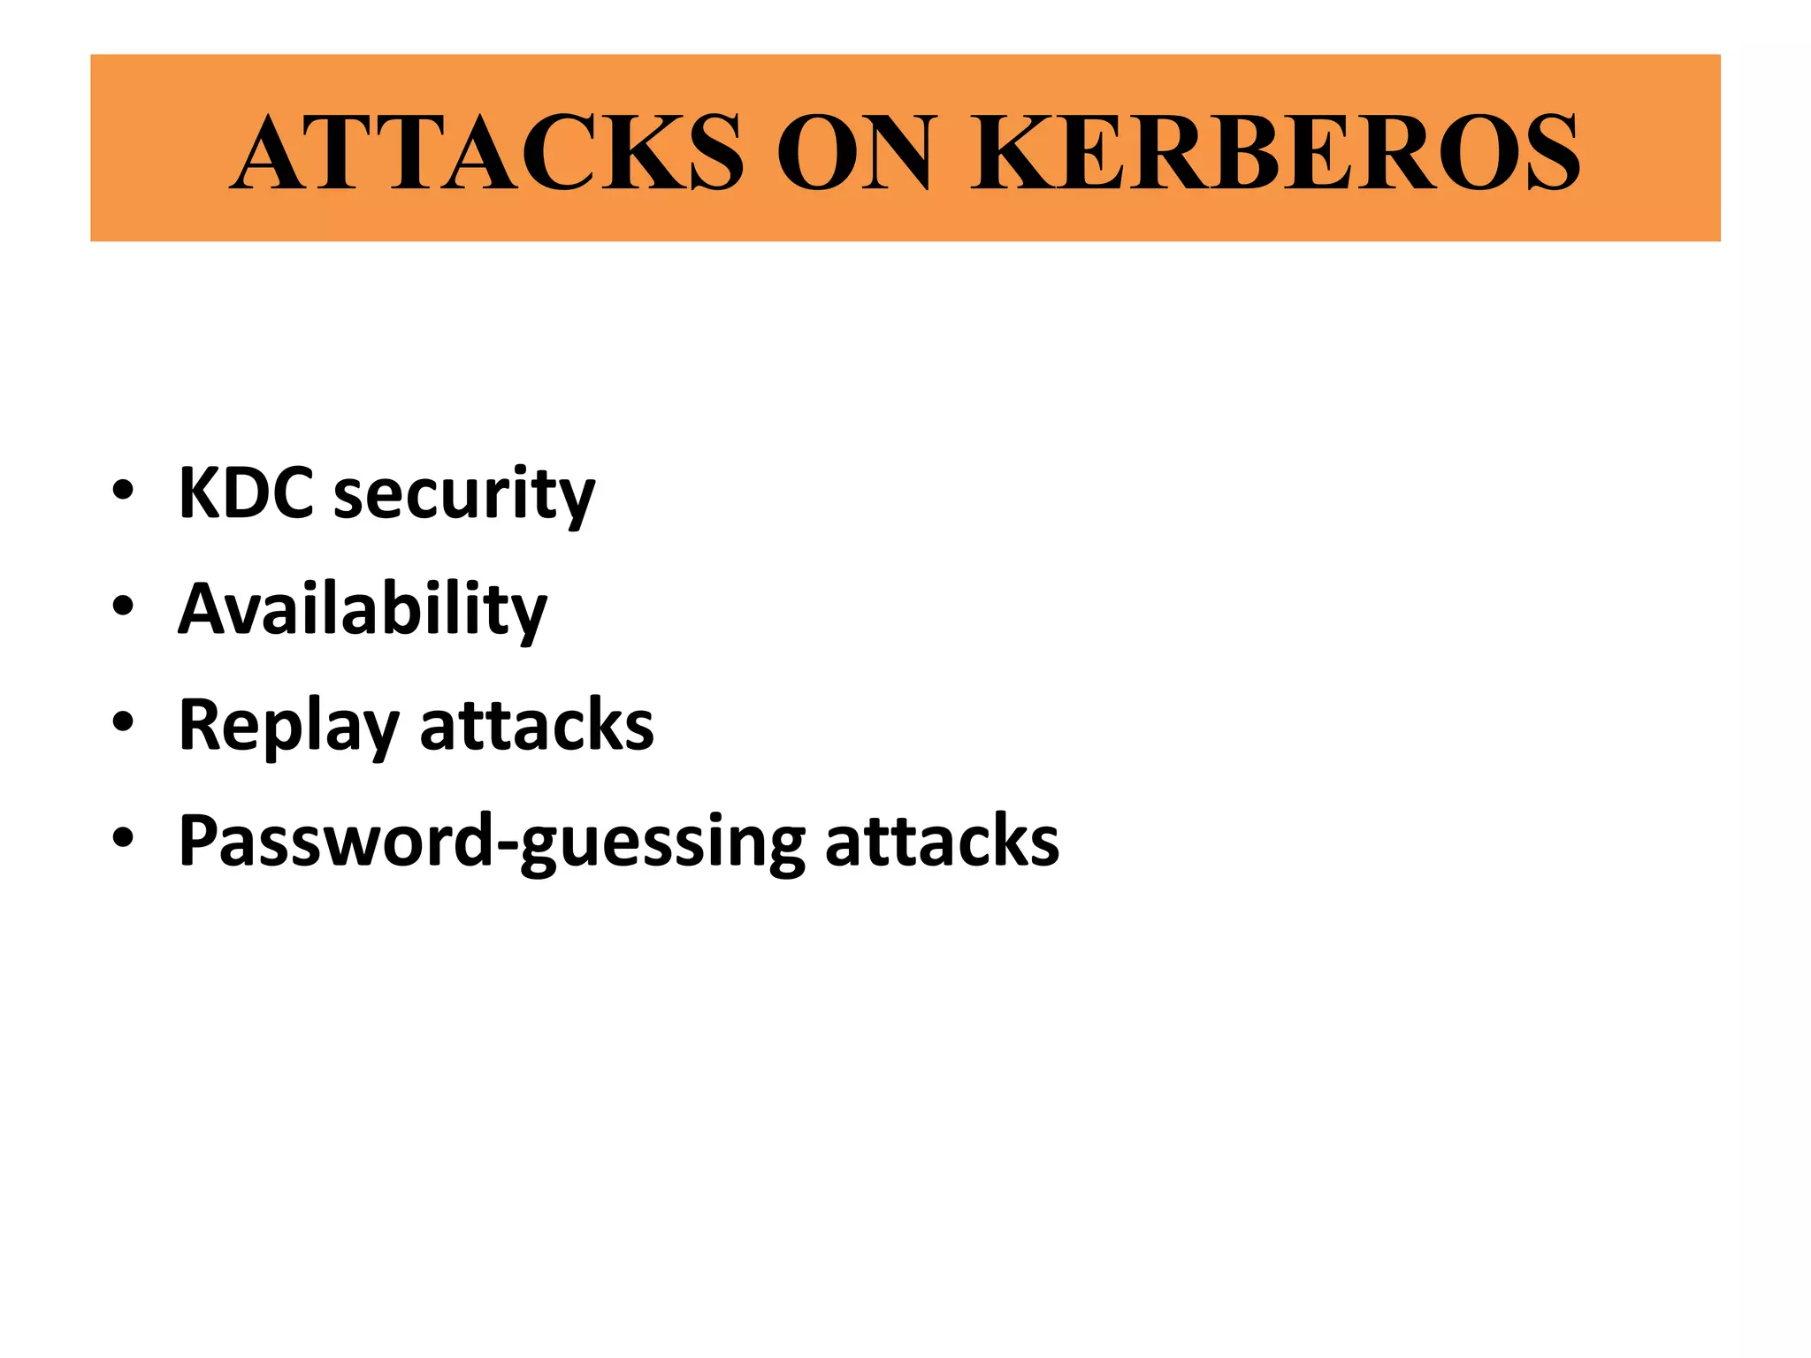
Notes:
Key Distribution Center (KDC)

